Slide 1

COMP 5350 / 6350 / 6356 Digital Forensics Spring 2019

Slide 2
Project #1 Questions

Slide 3
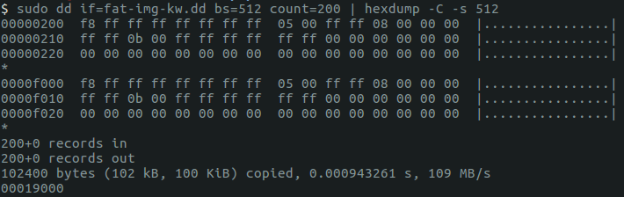
File Allocation Table - Correction
The file allocation table specifies where in storage the contents of a file reside
In order to find the contents of a file we will follow the next sector until an end of file marker is indicated
0xFFFF
The File Allocation Table only tells one part of the story, we will also need the directory entries to know which files are associated with which sectors in the FAT
FAT
Cluster | Next Cluster
0x0000 | 0xFFF8
0x0001 | 0xFFFF
0x0002 | 0xFFFF
0x0003 | 0xFFFF
0x0004 | 0x0005
0x0005 | 0xFFFF
0x0006 | 0x0008
0x0007 | 0x0000
0x0008 | 0xFFFF
0x0009 | 0x000B
0x000A | 0xFFFF
0x000B | 0xFFFF
0x000C | 0xFFFF
0x000D | 0x0000
0x000E | 0x0000
0x000F | 0x0000

Slide 4
Exam-Style Questions

Slide 5
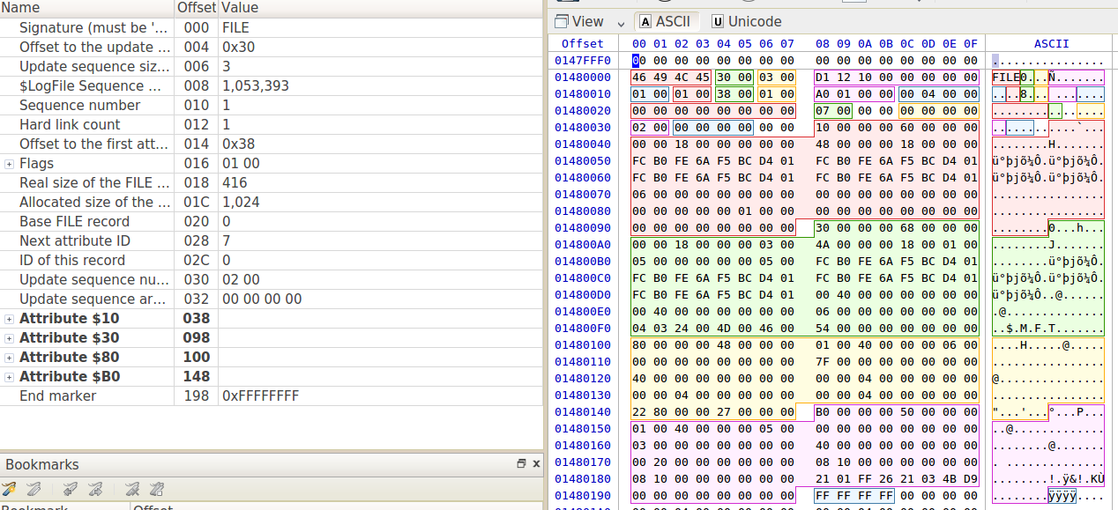
Which of the following file attributes are associated with the file below? (Select all that apply)
$STANDARD_INFORMATION
$FILE_ENTRY
$COMPRESSION
$DATA

Slide 6
Which of the following file attributes are associated with the file below? (Select all that apply)
$STANDARD_INFORMATION
$FILE_ENTRY
$COMPRESSION
$DATA

Slide 7
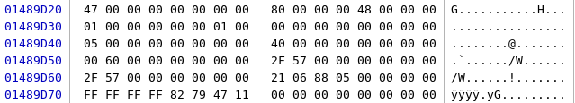
For the highlighted $DATA attribute for the NTFS file below, what is the current status of the file?
Active
Archive
Deleted
Hidden

Slide 8
For the highlighted $DATA attribute for the NTFS file below, what is the current status of the file?
Active
Archive
Deleted
Hidden

Slide 9
In order to capture a complete Windows Registry from main memory, what two activities must occur first?
System Boot
UEFI Access
User Authentication
LDAP Configuration

Slide 10
In order to capture a complete Windows Registry from main memory, what two activities must occur first?
System Boot
UEFI Access
User Authentication
LDAP Configuration
Windows
Boot
Volatile
Registry
Hives
Registry
Hive
Files
Disk
User
Authentication
Registry
Hive
Files
Processes
Main Memory

Slide 11
How many bytes are in each NTFS MFT entry?
512 bytes
1024 bytes
2048 bytes
4096 bytes

Slide 12
How many bytes are in each NTFS MFT entry?
512 bytes
1024 bytes
2048 bytes
4096 bytes

Slide 13
File Carving

Slide 14
Cluster-Based File Carving
Our discussions up to this point have focused on the use of a specific file systems to recover digital artifacts
This is a stepwise process which requires moving through the structures of each file system
Based on the structure of a given file system we can search for files along cluster boundaries
Cluster-Based File Carving (CBFC)
There will be times when digital evidence will be stored without the aid of a file system

Slide 15
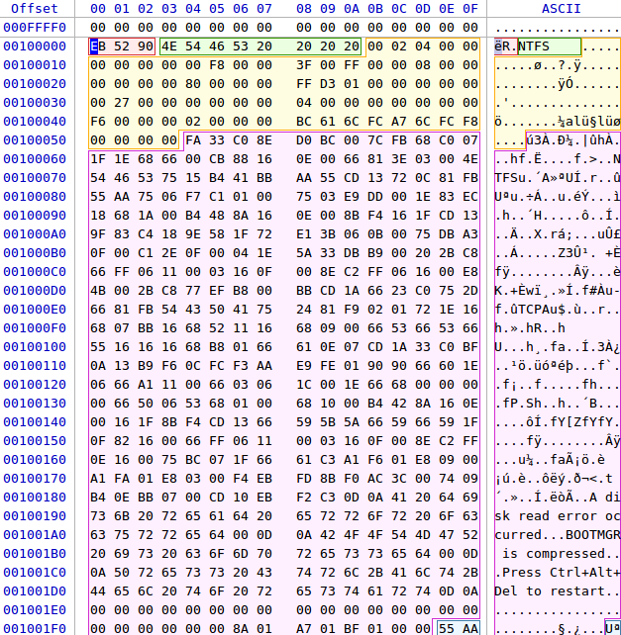
Cluster-Based File Carving - MBR
Master
Boot
Record
Master
File
Table
File
Data
Area
Master
File
Table
Backup

Slide 16
Cluster-Based File Carving - MFT
Master
Boot
Record
Master
File
Table
File
Data
Area
Master
File
Table
Backup

Slide 17
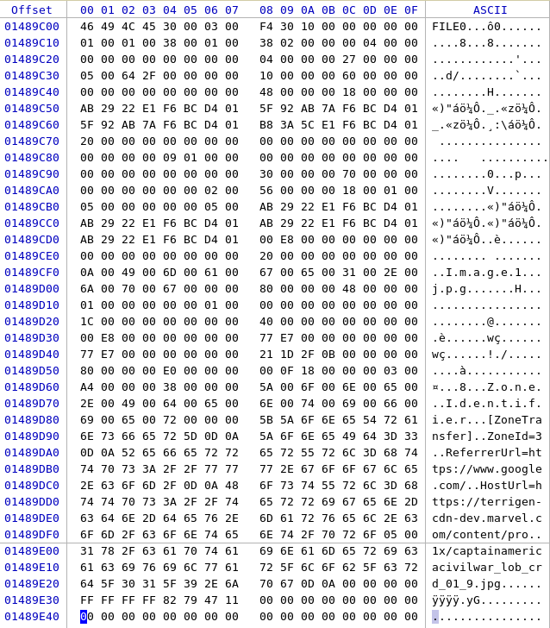
Cluster-Based File Carving – File Data
Master
Boot
Record
Master
File
Table
File
Data
Area
Master
File
Table
Backup

Slide 18
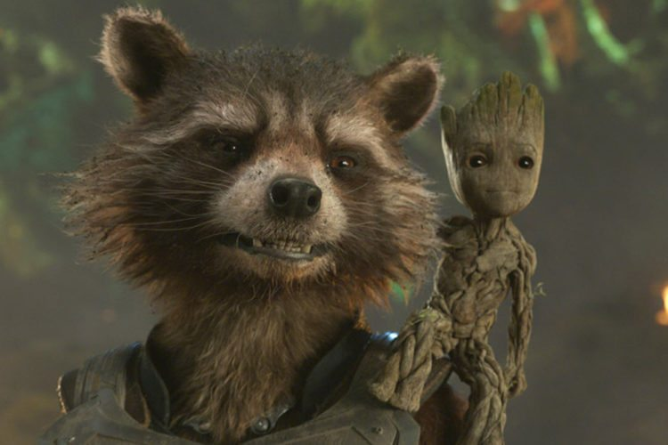
Cluster-Based File Carving - File Recovery
Determine file offsets
Find file name
Locate Storage Location
Recover file
File
Data
Area
sudo dd if=ntfs.dd of=Recovered.jpg bs=1 skip=657827 count=10252

Slide 19
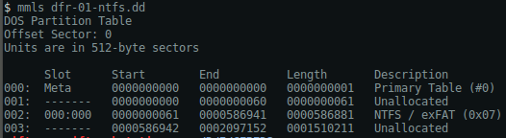
CBFC Automated Recovery - Partitions
DISK
PARTITION
FILE SYSTEM
DATA UNIT
METADATA
FILE NAME

Slide 20
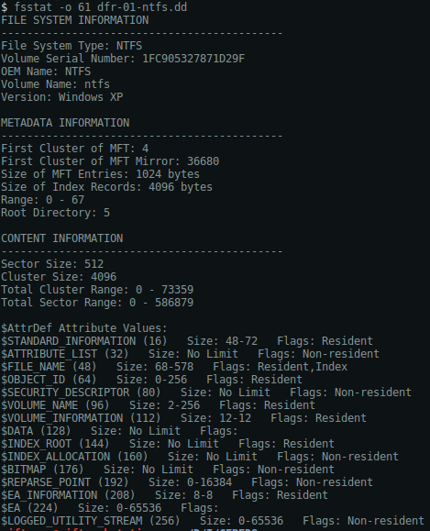
CBFC Automated Recovery – File System
DISK
PARTITION
FILE SYSTEM
DATA UNIT
METADATA
FILE NAME

Slide 21
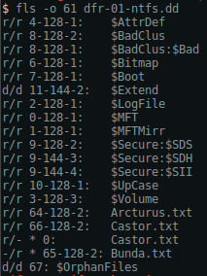
CBFC Automated Recovery – Inode
DISK
PARTITION
FILE SYSTEM
DATA UNIT
METADATA
FILE NAME
Inodes for
Deleted
Files

Slide 22
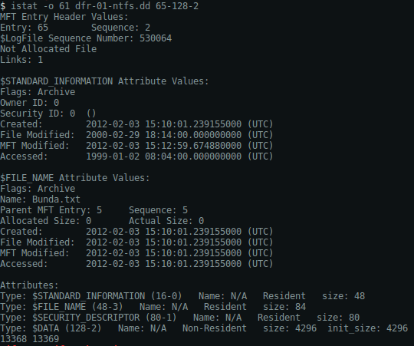
CBFC Automated Recovery – Inode
Partition
Offset
Inode
DISK
PARTITION
FILE SYSTEM
DATA UNIT
METADATA
FILE NAME
Sectors

Slide 23
CBFC - File Recovery
DISK
PARTITION
FILE SYSTEM
DATA UNIT
METADATA
FILE NAME
Partition
Offset
Inode
Recovery
Switch

Slide 24
Sector and Byte-Based File Carving
File carving is the process of extracting usable data from a storage device that is not formatted with a file system and does not search for files based solely on cluster boundaries
Sector-Based File Carving
Byte-Based File Carving
Disk space without formatting is generally defined as unallocated space
File carving requires significant understanding of file structures
In both forensic and security related applications, manipulation of application data and protocols can lead to system compromise

Slide 25
File Carving Techniques
Header & Footer File Carving
File recovery based on header and footer signatures
If no footer is defined, the maximum file size is used carve the correct amount of data
File Structure Carving
Utilizes a files internal layout and includes additional identifier strings
File Content Carving
Content structure is loose
HTML
XML
Content characteristics
Character count
Text/language recognition
White and black listing of data
Statistical attributes
Information entropy
Signal Randomness

Slide 26
Header & Footer File Carving
There are two ways files can be carved based on this method
Header / Footer Signatures
Header / Maximum File Size Signatures
Examples of known file signatures
MPEG, MPG, MPEG
0x000001Bx .... 0x000001B7
PDF
0x25504446 .... 0x0A2525454F46
GIF
0x474946383761 .... 0x003B
ZIP
0x504B0304 .... 0x504B .... 17 bytes .... 0x000000
JFIF, JPE, JPEG, JPG
0xFFD8FFE0xxxx4A46494600 .... 0xFFD9
DOCX, PPTX, XLSX
0x504B030414000600 .... 0x504B0506 .... 18 bytes
Signature search can be done directly with hex editor or can be automated programmatically

Slide 27
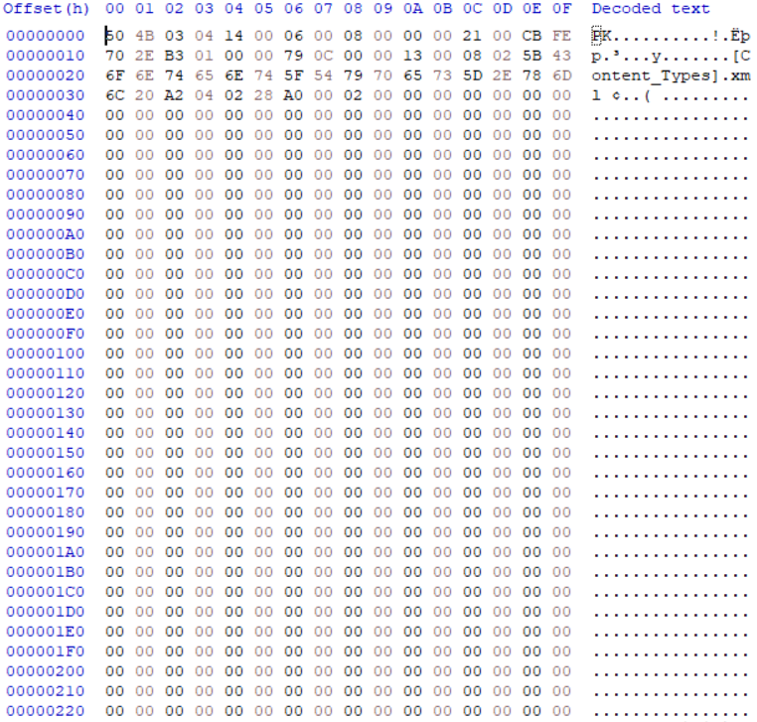

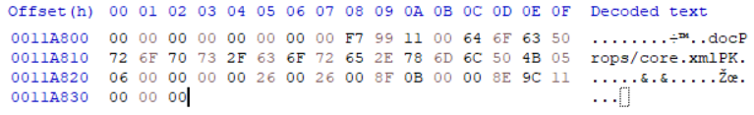
Header & Footer Example - DOCX, PPTX, XLSX
Header
Body
Footer

Slide 28
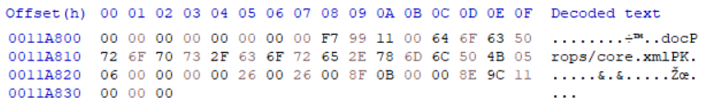
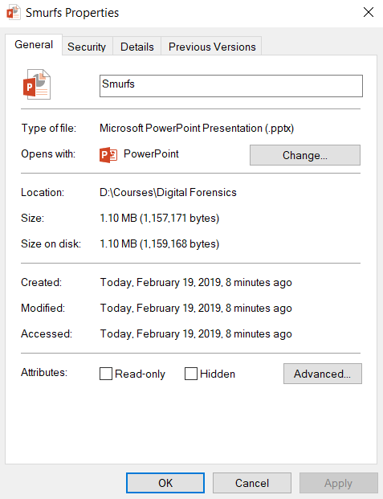
File Size Determination
0x11A833
1,157,171 bytes

Slide 29
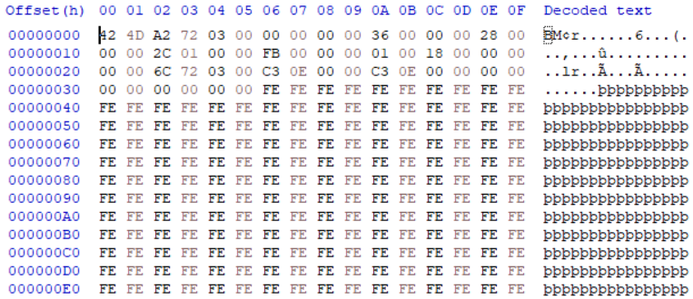

File Structure Carving
There will be cases when short signature headers will result in false positive results
To make the search result more effective, it is necessary to use wildcard or regular expression searches
It is necessary to understand the structure of each artifact
As an example, the BMP image file format which only has a 2 byte header “42 4D”

Slide 30
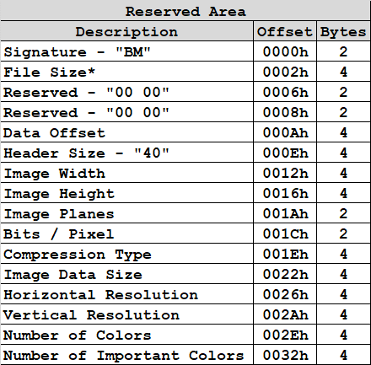
File Structure Carving - BMP
We can take advantage of the file structure to build a more robust search string
Byte offsets 0x6 – 0x9 are set to 0
Byte offsets 0xE – 0xF are set to 0x2800
The more unique the search string is, the less likelihood of a false positive
42 4D ? ? ? ? 00 00 00 00 ? ? ? ? 28 00

Slide 31
File Structure Carving - PCRE
Along with standard string matching techniques, we can also make use of Perl Compatible Regular Expressions (PCRE) to take advantage of known file structure
PCRE Symbol | Description
^ | Beginning of Line Match
. | Match Any Character
$ | End of Line Match
| | Select
() | Group
[] | Bracket Group
\ | Escape Character
\d | Any decimal digit
\D | Any non-decimal digit
\s | Any whitespace character
PCRE Symbol | Description
\w | Any word character (ld_)
\W | Any non-word character
\S | Any non-whitespace character
\t , \n | Tab, New Line
* | Match 0 or more times; {0,}
+ | Match 1 or more times {1,}
? | Match 0 or 1 times {0,1}
{n} | Match Exactly n times
{n,} | Match at least n times
{n,m} | Match n ≤ x ≤ m

Slide 32
File Structure Carving - PCRE
PCRE searches can be conducted through an API to existing applications or through a programmatic process
Some examples of file structure carving searches include:
String | PCRE | Description
User-Agent | ^User-Agent | Detects All Lines Starting With User Agent
12345 | [0-9]{5} | Matches on 5 consecutive numbers
abcdef | [a-z]{6} | Matches on 6 consecutive lowercase letters
F | [0-9A-Fa-f] | Match any hex value
A3FD020 | [0-9A-Fa-f]{7} | Matches on 7 consecutive hex values
[123] | \[[0-9]{3}\] | Escape brackets so they can be detected

Slide 33
File Structure Carving - PCRE
Create a PCRE that will match the wildcard string generated earlier:
42 4D ? ? ? ? 00 00 00 00 ? ? ? ? 28 00
^424D[0-9A-Fa-f]{8}0{8}[0-9A-Fa-f]{8}2800
Match the literal string “424D” at the beginning of the search
Match on 8 consecutive hex values
Match on 8 consecutive 0’s
Match on 8 consecutive hex values
Match the literal string “2800” at the beginning of the search

Slide 34
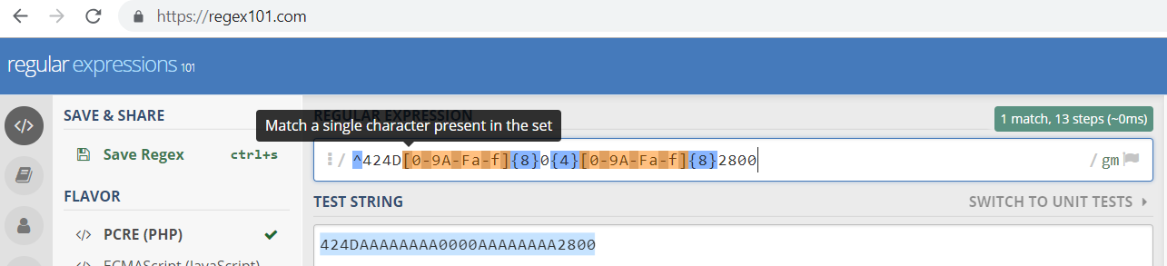
File Structure Carving – PCRE Validation
Before coding regular expressions into a solution, validate the filter against known inputs
This process will help with identifying digital artifacts and can be extended to other forensics areas including network analysis

Slide 35
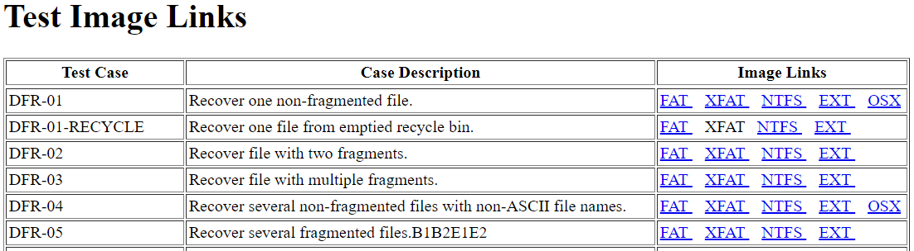
File Carving Examples
We will develop an understanding of how to analyze unallocated space by looking at some known file formats and protocols
The manual steps that we develop in the next few classes will help us to develop code to automate the process

Slide 36
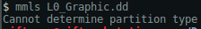
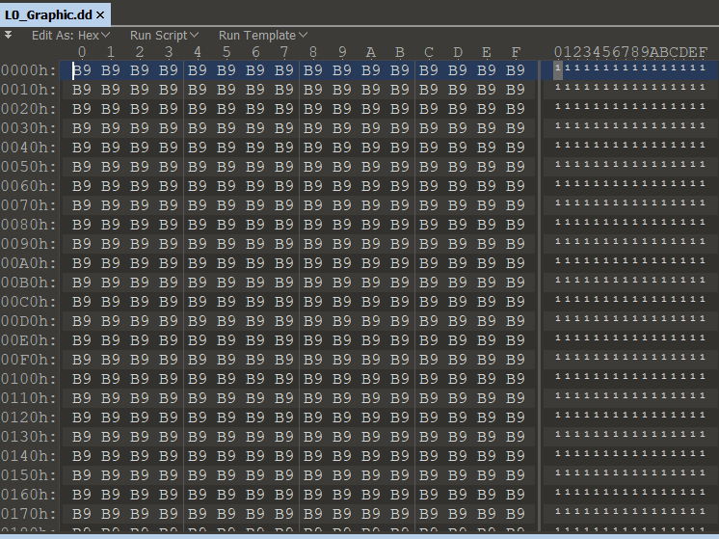
Non-Fragmented File Recovery
With sector and byte level file carving, the techniques used to analyze cluster-based files will fail
Consider unallocated space analysis

Slide 37
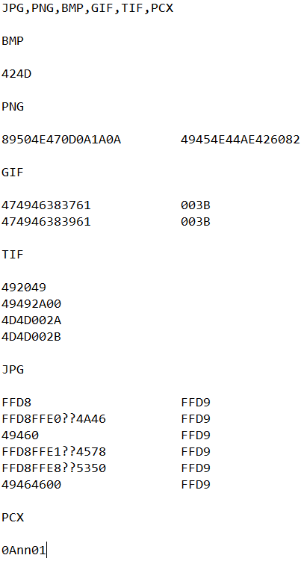
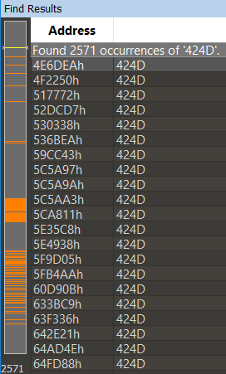
Header & Footer Testing
Attempt to find known header & footers

Slide 38
False Positives
Short search parameters will result in false positives
Modify the search parameters with as many known as possible

Slide 39
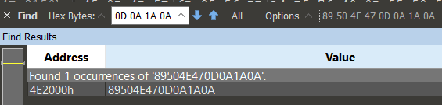
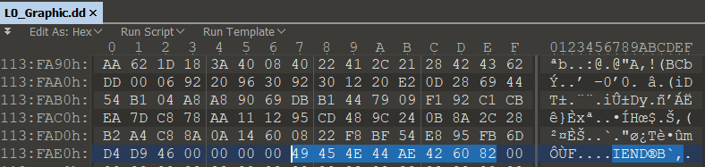
Header & Footer Results
Short search parameters will result in false positives so we will modify the search parameters with as many known as possible
89504E470D0A1A0A
Note starting location (0x4E2000)
With an initial candidate identified, determine if a footer is present
49454E44AE426082 (0x113FAEE)

Slide 40
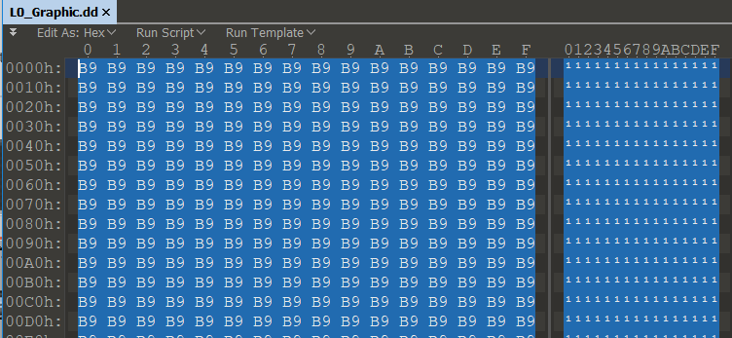
Remove Leading Values
Remove unnecessary values (0x0 - 0x4E1FFF)

Slide 41
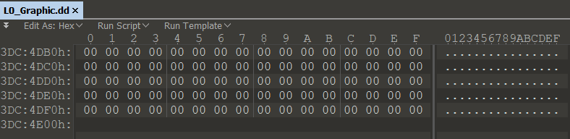
Remove Trailing Values
Remove unnecessary values (0x113FAEF – 0x3DC4E0F)

Slide 42

Recover Carved File
At this point, the file have been carved and is ready for analysis

Slide 43
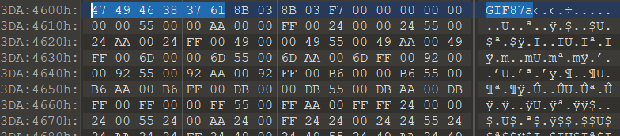
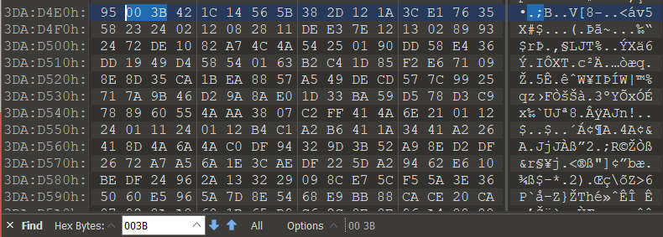
Expected Results
Conducting additional analysis on this image results in other findings, but much different results

Slide 44
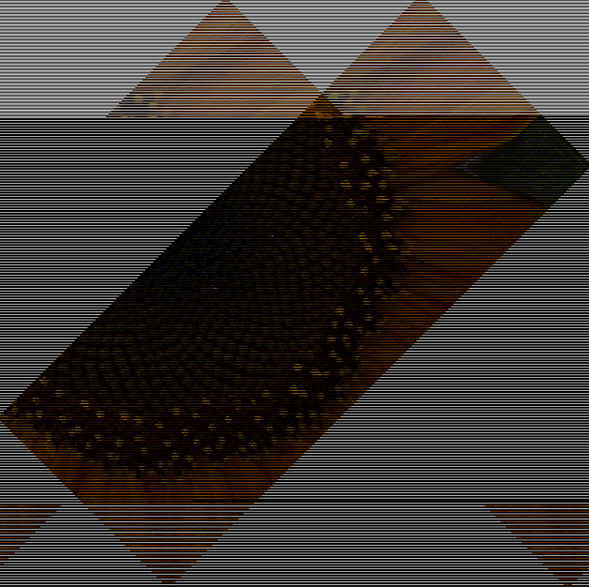
Recover Carved File
At this point, the file have been carved and is ready for analysis

Slide 45
File Carving Considerations

Slide 46
Overwritten Files
When stepping through the file carving process, there will be times when files have been overwritten
Since deleted files are marked for future writes, there is nothing preventing part or complete overwrite
File data saved in the data area generally contain header, body, and footer information
Forensic examiners attempting to recover data may only be able to build parts of files due to corruption or active manipulation
Header
Body
Footer

Slide 47
Anti-Forensics
Anti-Forensics covers “any attempts to alter, disrupt, negate, or in any way interfere with scientifically valid forensic investigations”
There are numerous methods employed by attackers to circumvent or attack forensic analysis techniques
There are six broad categories of anti-forensics:
Artifact Wiping
Trail Obfuscation
Data Hiding
Encryption
Steganography
Attacks Against Forensics Tools & Methods

Slide 48
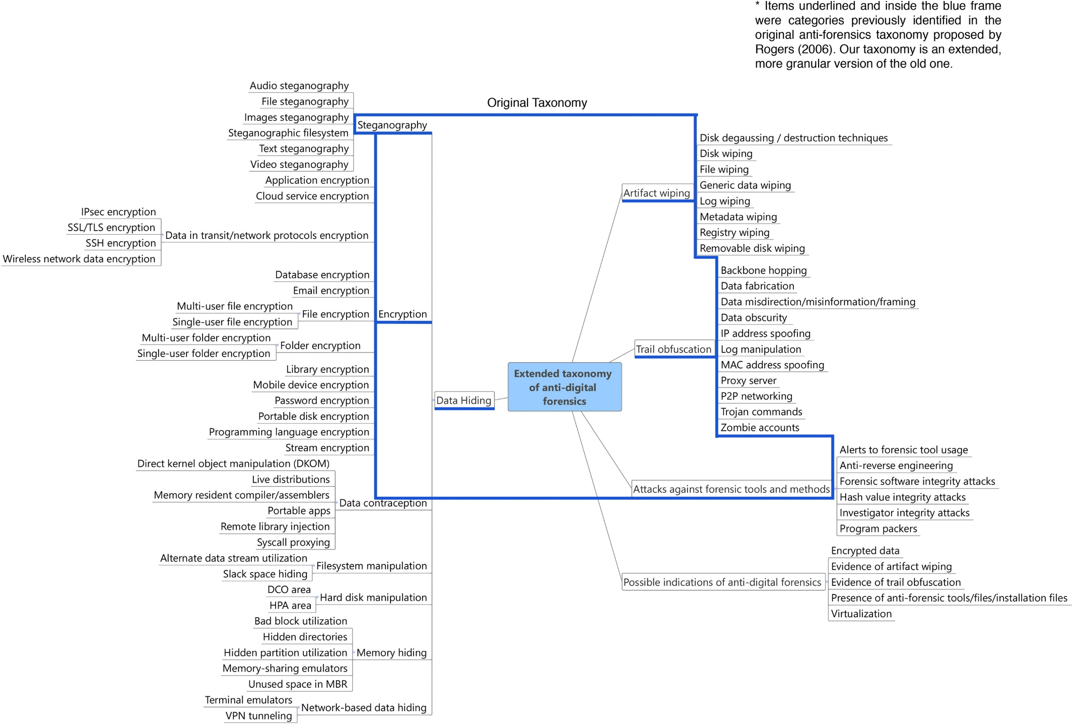
Anti-Forensics

Slide 49
Anti-Forensics
An analysis of over 300 anti-forensics tools indicated the following distribution of capabilities:
Data hiding (153)
Artifact wiping (113)
Trail obfuscation (38)
Steganography (16)
Attacks Against Forensic Tools & Processes (4)
Additional anti-forensics tools outside of the general categories included:
Network-Based Data Hiding (6)
Filesystem Manipulation (2)
Data Contraception (1)
Memory Hiding (1)

Slide 50
References
Windows Forensics Analysis Toolkit, Carvey, 2014
Windows Registry Forensics, Carvey, 2009
File Carving Techniques
https://resources.infosecinstitute.com/file-carving/#gref
File Carving Test Images
https://www.cfreds.nist.gov/dfr-test-images.html
Anti-Forensics
https://doi.org/10.1016/j.diin.2016.04.006

